Slide 1
Cybersecurity: Top Trends, Tactics, and Threats
FMA Securities Compliance Seminar
April 23, 2025
Matt White
AIGP, CIPP/US, CIPP/E, CIPT, CIPM, PCIP
SHAREHOLDER, BAKER DONELSON
MEMPHIS, TN
901.577.8182
mwhite@bakerdonelson.com

Slide 2
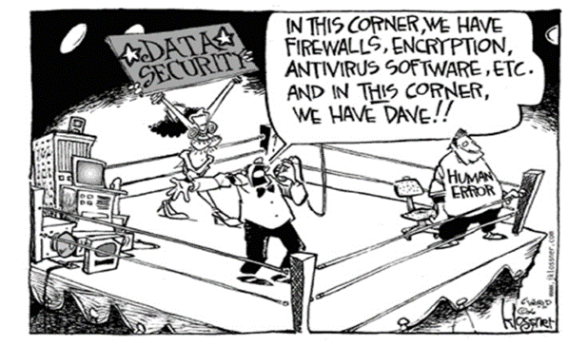
Right now, there may be no greater risk to organizations than cyber insecurity

Slide 3
THE EVOLVING LANDSCAPE OF CYBERSECURITY
Advanced Technology
Sophisticated Attacks
Increased Costs
Cutting-edge technology being used by organizations
More devices + More connectivity = More opportunities for attacks
Cyberattacks have become more sophisticated
Difficult to detect and presents substantial legal, operational, and reputational risk
Global annual cost of cybercrime is predicted to reach $8 trillion in 2023

Slide 4
THREAT BRIEFING
Overview of recent developments, legal issues, and threats

Slide 5
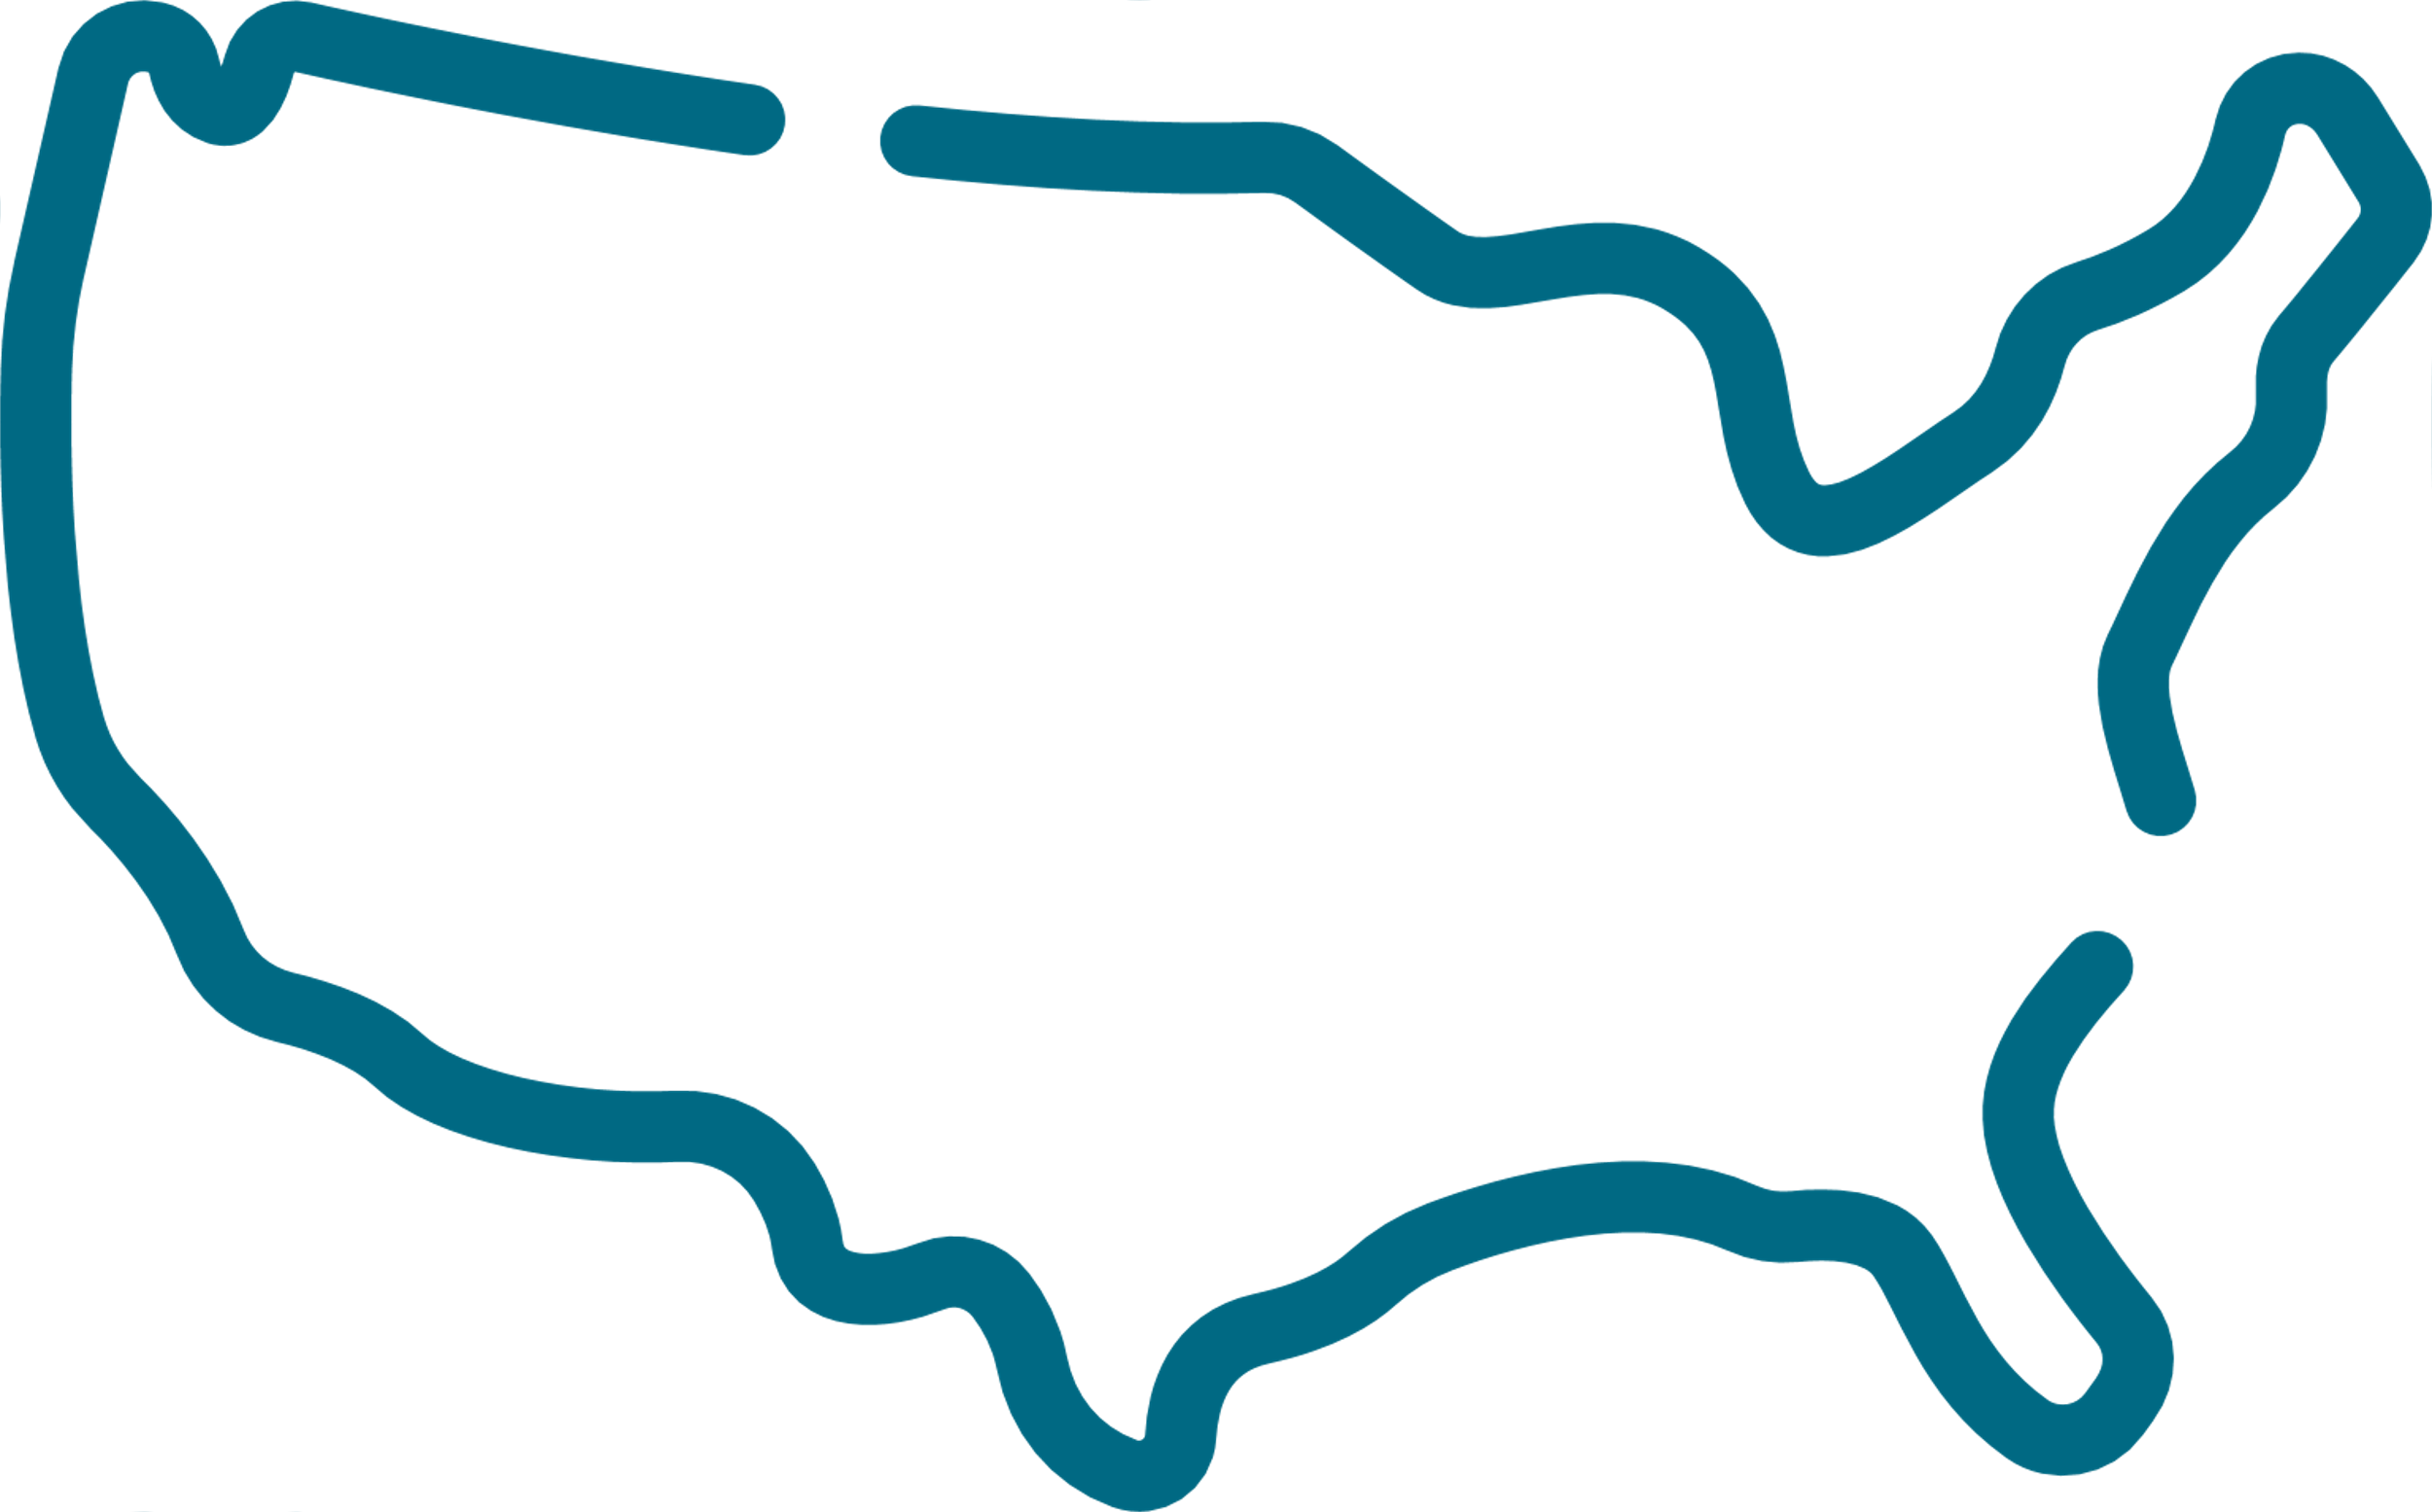
BREACH COSTS AND TRENDS
$6.08M
292
70%
63%
Average cost of a data breach for the financial sector in 2024
Average Number of Days to Identify + Contain a Breach
Organizations that experienced a “significant” or “very significant” disruption to business
Ransomware victims that involved law enforcement and did not pay a ransom

Slide 6
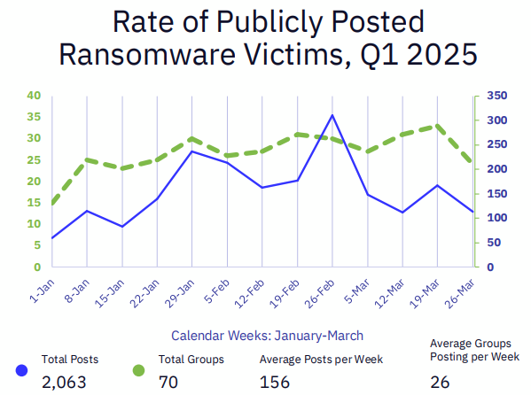
CYBER THREAT TRENDS IN 2025
Ransomware-as-a-Service Cybercrime's Franchising Model
Supply Chain Vulnerabilities The Domino Effect
AI-Powered Cyber Attacks When the Machines Fight Back
Deepfakes Lies in High Definition
The Human Factor Insider Threats + The Eternal Weak Link

Slide 7
THE BASICS OF RANSOMWARE
WHAT IS RANSOMWARE?
DOUBLE EXTORTION
Malware that encrypts data on systems to lock you out
Threat actors demand a ransom to “decrypt” the systems
Threat actor steals data and encrypts systems
EXTORTION
TRIPLE EXTORTION
Systems encrypted OR data stolen and demand of ransom to resolve
Stolen Data
Encrypts Systems
Intimidating Third Parties

Slide 8
Determining whether or not to pay a ransom is often a difficult (and expensive) decision which includes significant legal considerations.
Office of Foreign Assets Control (OFAC): OFAC has a “sanctions list” that prohibits ransom payments to specified threat actor groups.
Civil penalties may be imposed for violations
State Law Prohibitions: Certain states have enacted laws prohibiting public agencies and municipalities from paying ransoms and/or use of taxpayer funds for payment of ransoms
No federal laws specifically limit payment of ransoms, but several federal agencies have issued guidance against such payments
Critical to always involve legal counsel and other third-party experts before deciding whether or not to make a payment.
To Pay or Not To Pay a Ransom

Slide 9
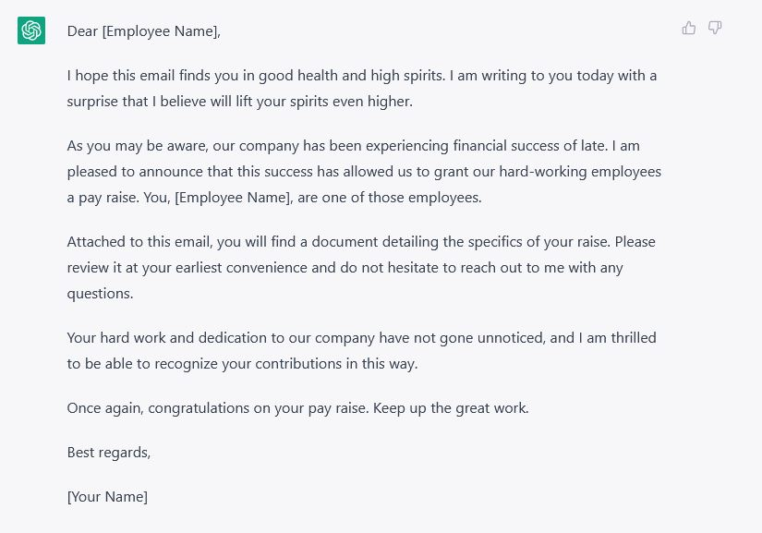
CYBERATTACKS POWERED BY AI
Deepfakes
Impersonating company representatives, government officials, celebrities, etc.
Phishing Attacks
More sophisticated, better at impersonation, challenging to detect

Slide 10
IN THE NEWS
Key takeaways from recent, high-profile cyberattacks

Slide 11
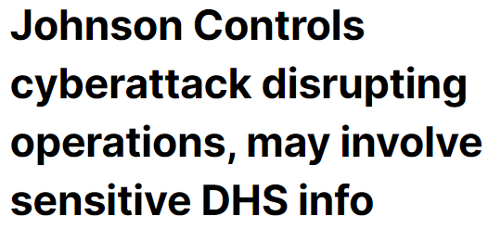
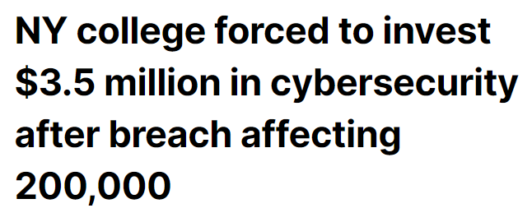
HEADLINES AND RECENT ATTACKS

Slide 12
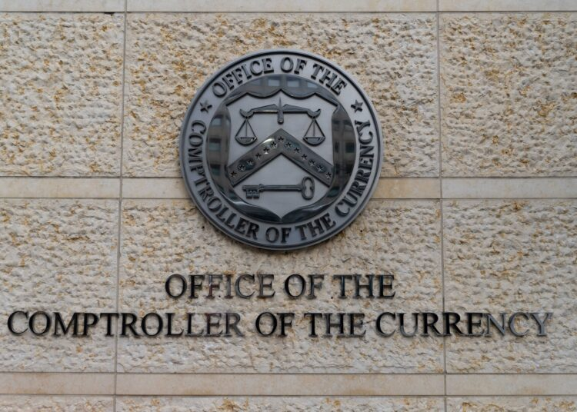
OFFICE OF THE COMPTROLLER OF THE CURRENCY
In February, the OCC disclosed that an unauthorized user accessed “a number” of OCC user accounts, including emails and attachments.
Over 100 email accounts were compromised and included “highly sensitive information” relating to the financial condition of regulated institutions.
OCC recently stated that it plans to contact financial institutions and advise if their data was exposed.
Several large banks have paused electronic information sharing with the OCC.

Slide 13
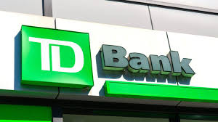
TD BANK
In February 2025, TD Bank disclosed a breach upon discovering that a former employee improperly accessed and shared sensitive customer information.
Activity purportedly occurred between August-December 2024.
Impacted customers experienced fraudulent activity on their financial accounts.
At least once class action lawsuit has been filed as a result of the incident.

Slide 14
NATIONAL PUBLIC DATA
National Public Data (NPD) reported in August 2024 that a threat actor compromised its network in December 2023 and leaked certain data beginning in April 2024.
NPD provides background checks which includes information from legitimate sources and data scraped from websites.
NPD’s official notice filed with the Maine Attorney General stated that 1.3 million records may have been compromised.
However, a class action lawsuit alleges that more than 2.9 billion personal records may have been exposed.

Slide 15
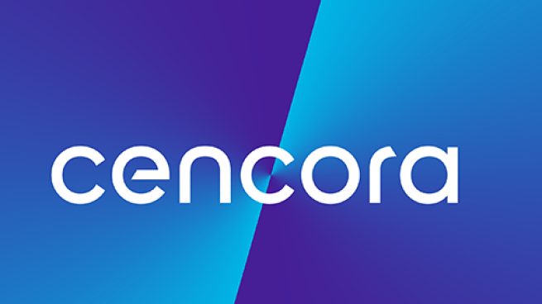
CENCORA (f/k/a AmerisourceBergen)
Pharmaceutical giant reported in May 2024 that it experienced a cyberattack resulting in “personal and highly sensitive information” being stolen.
Organization has provided few details about the incident which resulted in over 1.4 million individuals being notified.
Reported that initial ransom demand was $150 million.
Cencora reportedly paid a $75 million ransom in three Bitcoin installments.
Amount is known to be the largest ransom ever paid.

Slide 16
$25 MILLION DEEPFAKE SCAM
Multinational company’s Hong Kong office recently fell victim to a deepfake scam which resulted in a $25 million loss.
Scam recreated company’s CFO and other employees in a video conference call and instructed an employee to transfer funds.
All participants on the call were fabricated individuals – except the victim that transferred the funds.
The fraud was initially uncovered following a phishing attempt where employee in finance department received an email from the CFO instructing a secret transaction.
Employee then completed 15 transfers to 5 different bank accounts.

Slide 17
REGULATORY UPDATES
OVERVIEW OF NEW REGULATIONS IN 2025

Slide 18
Incident Reporting
Board Oversight
Role of Management
Form 8-K must be filed within 4 business days of determining that an incident is “material”
Describe the role of the board of directors in overseeing cyber risk
Detail responsible positions + processes to monitor and manage material risks
B
D
5
PRIMARY COMPONENTS OF THE SEC CYBERSECURITY DISCLOSURE RULES
A
C
E
Risk Management
Forms 10-K and 20-F must describe processes for assessing, identifying, and managing material risks from cyber threats
Third Party Relationships
Identify whether any third-parties are engaged to assist with cyber risk management processes

Slide 19
FTC’s new breach reporting requirements for non-banks went into effect in May.
Application: Rule applies to all non-banking financial institutions regulated by the FTC
Includes mortgage brokers, financial planners, credit reporting agencies, tax preparers, etc.
Requirements: Any “notification event” involving the information of at least 500 consumers must be reported to the FTC no later than 30 days after discovery.
Notification Event: A notification event means the acquisition of unencrypted customer information without the authorization of the customer.
Scope of “customer information” that would trigger notification requirements is broader than standard state notification laws.
FTC BREACH REPORTING REQUIREMENTS FOR NON-BANKS

Slide 20
PROPOSED HIPAA SECURITY RULE UPDATES
Notice of Proposed Rulemaking: U.S. Department of Health and Human Services (HHS) issued its official Notice of Proposed Rulemaking to update the HIPAA Security Rule on January 6, 2025.
This is the first update in a decade
More Requirements: The proposed updates are intended to bring specificity to requirements for electronic protected health information (ePHI) and to better align with the NIST Cybersecurity Framework.
Removes distinction between “required” and “addressable” implementation specifications and makes all specifications required with specific, limited exemptions.
New standards to address asset inventory, compliance audits, patch managements, encryption/decryption, configuration management, data backups, etc.
Written Documentation: Specifies requirement for written documentation for all Security Rule policies and procedures.
Additional requirement to review/update/verify policies at least once every 12 months
Next Steps: Comment period ends on March 7, 2025.

Slide 21
HUD CYBER INCIDENT REPORTING REQUIREMENT
December 2024: U.S. Department of Housing and Urban Development (HUD) issued Revised Cyber Incident Reporting Requirements.
This was in response to initial rule in May that was sharply criticized by the banking and housing industries and aligns more with requirements of FHA and bank regulators.
Timing: FHA-approved mortgagees must notify HUD no later than 36 hours after determining that a “Reportable Cyber Incident” has occurred.
“Reportable Cyber Incident” is an incident that has or is reasonably likely to “materially disrupt or degrade” the mortgagee’s ability to meet its obligations for originating or servicing FHA-insured mortgages.
Incident must result in actual harm to an information system or the information that the system processes, stores, or transmits.
Reporting Requirements: Information required is more detailed than other rules
Must identify any impacted parent companies or subsidiaries
Notification required to two separate email addresses

Slide 22
ADDITIONAL DEVELOPMENTS
Other issues to watch

Slide 23
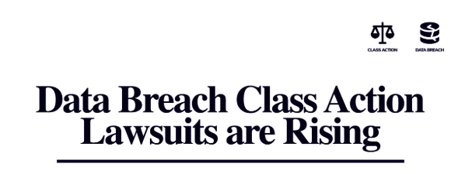
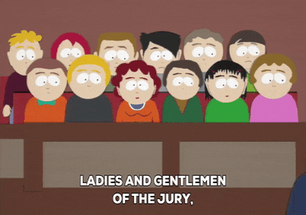

Slide 24
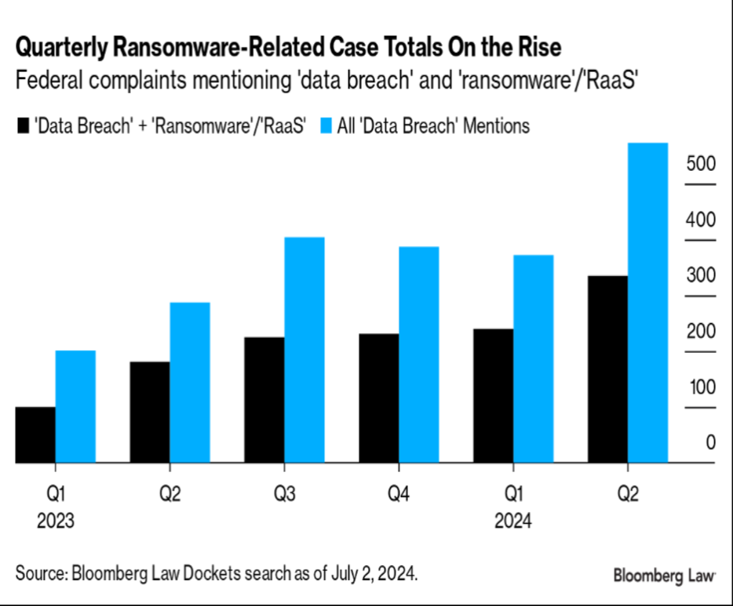
DATA BREACH LITIGATION TRENDS
Source: Bloomberg Law - Ransomware Attacks: Litigating a Growing Threat

Slide 25
BEST PRACTICES
Incident Response Plan Review
Review written plan for responding to cyber incidents + identify third-party vendors who may assist.
Conduct a Tabletop Exercise
Conduct routine tabletop exercises to test its incident response plan.
Review Incident Response Plan
Conduct a Tabletop Exercise
Emerging Technologies
Assess Emerging Technologies
Evaluate options for new technologies (AI, etc.) to improve cybersecurity posture.
Vendor Management
Evaluate vendor management program and ensure agreements require adequate security controls.
Cyber Insurance
Assess the current cyber insurance policy to ensure sufficient coverage and potential exclusions.
Vendor Management
Cyber Insurance
Data Mapping Procedures
Data Mapping Procedures
Conduct a data mapping exercise to evaluate what information is collected, where it is stored, etc.

Slide 26
ABOUT US

Slide 27
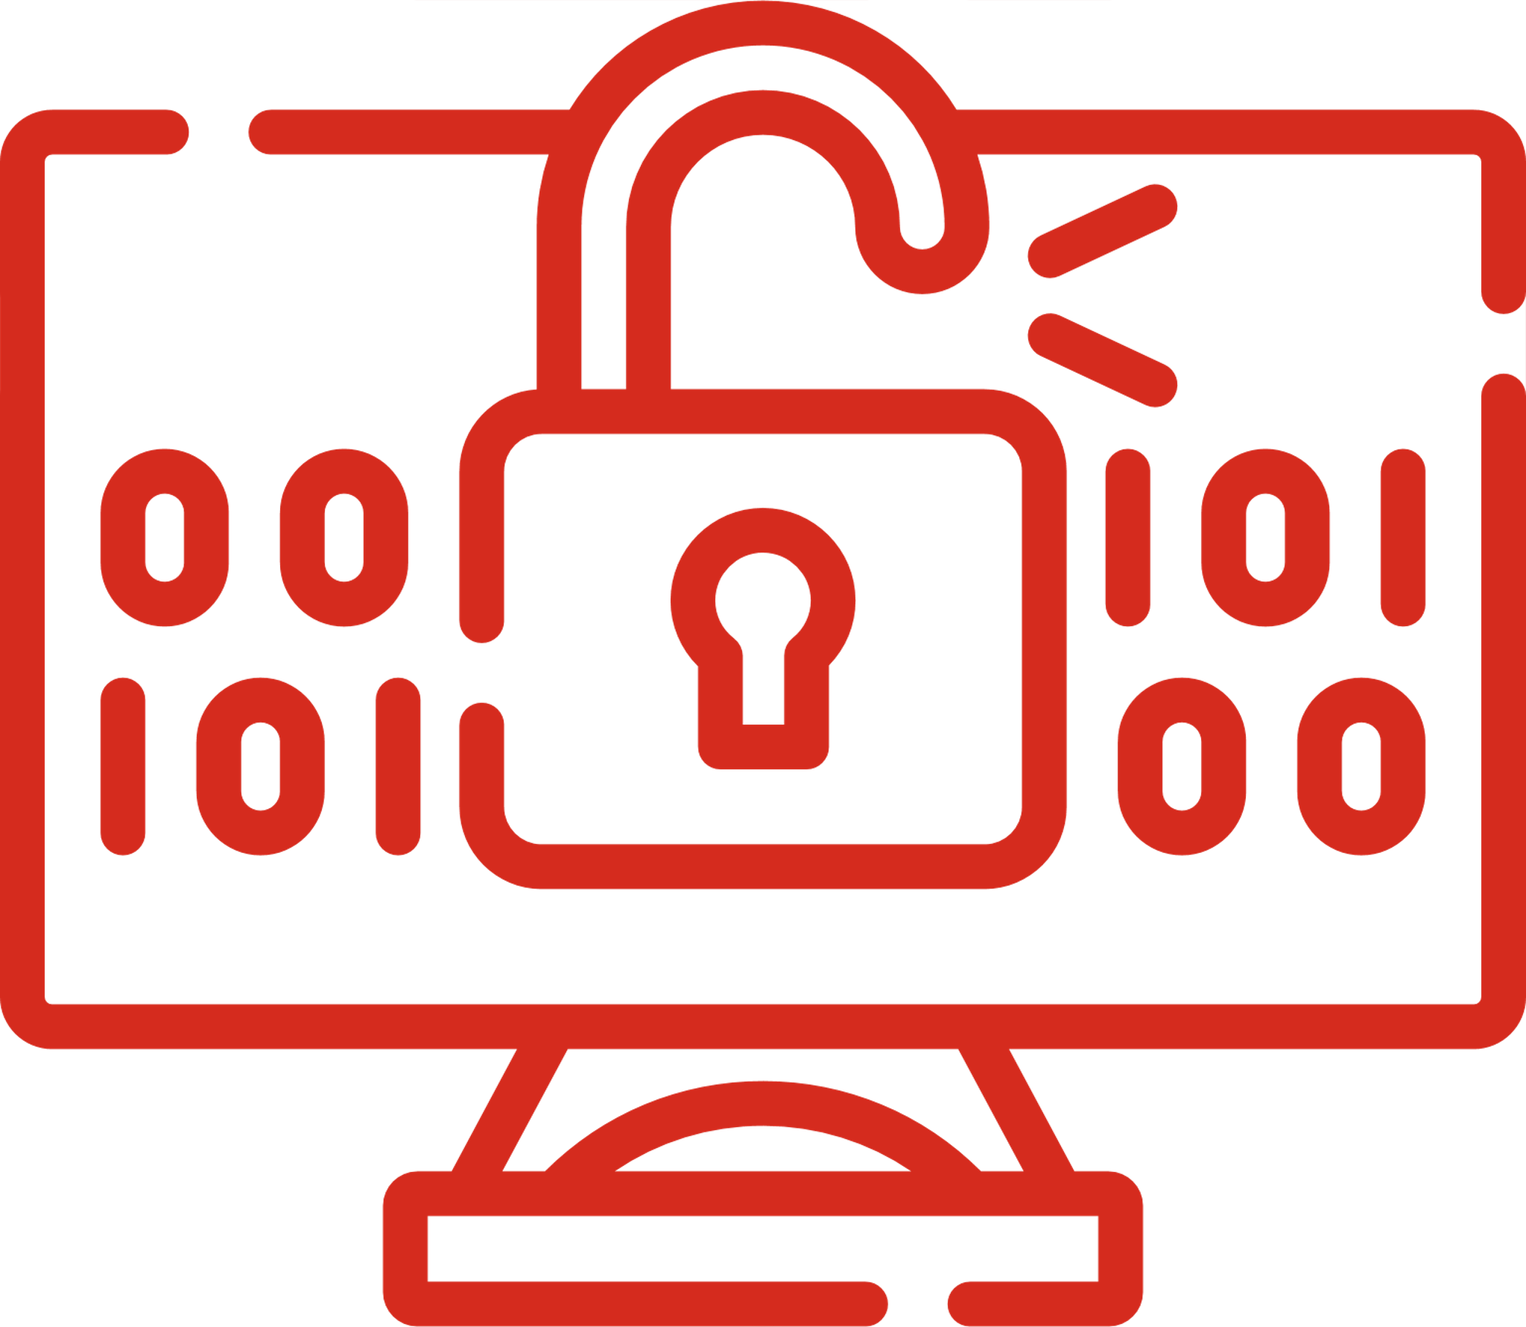
BAKER DONELSON’S DATA PROTECTION, PRIVACY, AND CYBERSECURITY TEAM
WHAT WE DO
Overview of Proactive Services
Data privacy and information security compliance plans
Website privacy policies and terms of use
Incident response planning
Tabletop exercises
Board level and c-suite training and guidance
Business continuity and disaster recovery plans
International data transfer & data protection agreements
Document retention and destruction plans
Due diligence review for mergers and acquisitions
Cyber coverage analysis
Vendor agreement preparation and review
Crisis Communications
Employee training
Employment and social media considerations
Data Privacy Compliance
Cybersecurity Readiness
Tabletop Exercises & Breach Simulations
Data Incident and Breach Response
Regulatory Enforcement and Litigation
Artificial Intelligence & Emerging Technologies

Slide 28
Matt White is co-chair of the Firm's Financial Services Cybersecurity and Data Privacy Team, and a member of the firm’s Incident Response Team, which has been named an Authorized Breach Coach® by NetDiligence. He regularly advises clients on a wide range of cybersecurity and data privacy matters, including compliance, policies and procedures, training, incident response, regulatory investigations, and litigation.
He is a Certified Information Privacy Professional (CIPP/US, CIPP/E), a Certified Information Privacy Technologist (CIPT), and a Certified Information Privacy Manager (CIPM). Matt is also a Payment Card Industry Professional (PCIP). His practice focuses on representing financial institutions, including banks, credit unions, lenders, Fintechs, insurance companies, InsurTechs, investment advisory firms, and broker-dealer firms, as well as other highly regulated businesses. He counsels clients on all aspects of privacy and cybersecurity, including litigation and breach response, privacy compliance, transactional diligence, and the defense of regulatory actions. Matt particularly focuses on helping businesses implement policies, procedures, and best practices concerning data privacy and security, and assisting clients in strategically navigating through cyber incidents and litigation.
Matt also provides strategic advice to his clients concerning artificial intelligence (AI), blockchain technology, smart contracts, cryptocurrencies, and other digital assets including non-fungible tokens (NFTs). He provides sophisticated and knowledgeable counsel on the novel issues clients encounter in this rapidly evolving space.
Matt White, AIGP, CIPP/US, CIPP/E, CIPT, CIPM, PCIP
Shareholder
Memphis, TN
901.577.8182
mwhite@bakerdonelson.com

Slide 29
www.bakerdonelson.com
@BakerDonelson
@Baker-Donelson
@Baker_Donelson

