Slide 1
2025 Securities Compliance Seminar
The Marketing Rule – Two+ Years Later:
Cases and Lessons Learned
Presented by:
Jennifer Selliers, Christine Ayako Schleppegrell, and Trish Flynn

Slide 2
Presenters
Jennifer Selliers
Christine Ayako
Schleppegrell
Trish Flynn

Slide 3
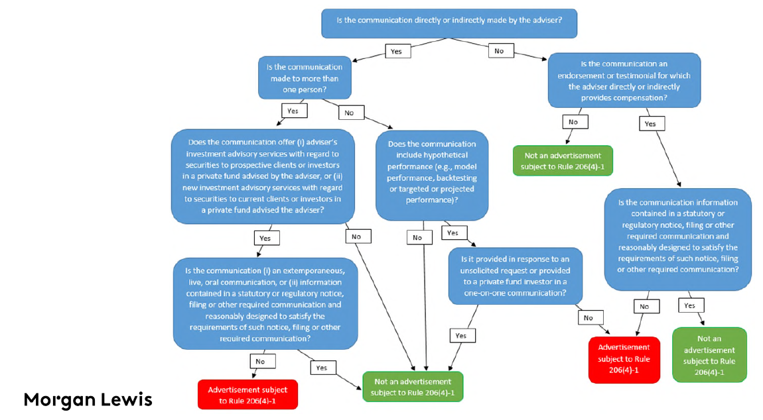
What Is An Advertisement?

Slide 4
Overlap with FINRA Advertising
How does the marketing rule overlap with FINRA 2210 – Communications?
SEC Section | Rule 206(4)-1 |  | FINRA Section | 2210(d) - Standards of Communication (FINRA)
(a)(1) | Statements are true and factual |  | (1)(A)
(a)(2) | Reasonable basis and ability to substantiate |  | (1)(B)
(a)(3) | No misleading inferences |  | (1)(C) | Specific to legend/footnote
(a)(4) | Fair and balanced (risks and benefits of services) |  | (1)(D)
(a)(5) | Fair and balanced (specific investment advice) |  | (1)(E) | Nature/appropriate to audience
(a)(6) | Fair and balanced (performance)
(a)(7) | Not materially misleading |  | (1)(A)
2214 - Investment Analysis Tool (FINRA) | Rule 206(4)-1(e)(8) Investment Adviser Act
An interactive technological tool that produces simulations and statistical analyses that present the likelihood of various investment outcomes if certain investments are made or certain investment strategies or styles are undertaken, thereby serving as an additional resource to investors in the evaluation of the potential risks and returns of investment choices | An interactive analysis tool where a client or investor, or prospective client, or investor, uses the tool to produce simulations and statistical analyses that present the likelihood of various investment outcomes if certain investments are made or certain investment strategies or styles are undertaken, thereby serving as an additional resource to investors in the evaluation of the potential risks and returns of investment choices SEC "requires that a current or prospective investor must use the tool (i.e., input information into the tool or provide information to the adviser to input into the tool)" ** The SEC and FINRA definitions of "investment analysis tool" vary slightly; see pg. 214 - 215 of the SEC Release

Slide 5
Policy and Procedure Best Practices
Developing effective policies and supervisory procedures (target areas)
Placement Agents / Promoters
Performance and “Characteristics”
Foreign promoters / extraterritoriality
Adviser forming reasonable basis belief
Placement of disclosure
Unique promoter arrangements
Collateral consequences analysis: disqualification
New FAQs: implementation / changes to practices
Hypothetical and extracted performance
Model fees and restating historical performance
Client reporting v. an advertisement
Impact of 506(c) no-action relief

Slide 6
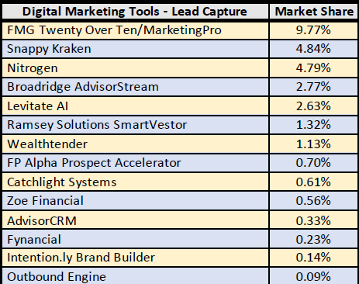
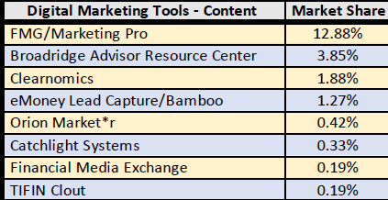
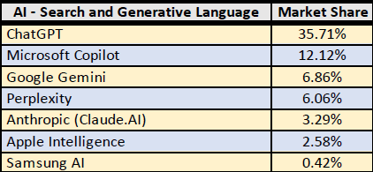
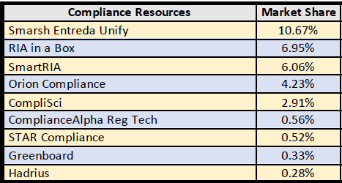
Marketing workflows –
Systems and services for managing workflows
Lead Capture Tools
Content Providers
AI Search and Generative Language
Compliance Resources
Source:T3Inside-Information-2025-Software-Survey.pdf

Slide 7
Using AI To IA –
Providing Investment Advice
AI washing
Recordkeeping concerns
Use of IA for external v. internal purposes
External = advertising, making investment decisions, portfolio management
Internal = streamlining compliance, doing more with less (e.g., fewer internal resources and staff members)

Slide 8
Case Study Reference Sheet
Cases
SEC.gov | SEC Charges FinTech Investment Adviser Titan for Misrepresenting Hypothetical Performance of Investments and other Violations (Aug. 21, 2023)
SEC.gov | SEC Sweep into Marketing Rule Violations Results in Charges Against Nine Investment Advisers (September 11, 2023)
SEC.gov | SEC Charges Five Investment Advisers for Marketing Rule Violations (April 12, 2024)
SEC.gov | SEC Charges Washington-Based Registered Investment Adviser with Marketing Rule Violation (August 9, 2024)
SEC.gov | SEC Charges Nine Investment Advisers in Ongoing Sweep into Marketing Rule Violations (September 9, 2024)
SEC.gov | SEC Charges New York-Based Registered Investment Adviser with Marketing Rule Violations (November 1, 2024)
SEC.gov | SEC Charges California-Based Investment Adviser with Marketing Rule, Policies and Procedures, and Recordkeeping Violations (December 20, 2024)

Slide 9
Resources:
FAQs (Last updated March 19, 2025): SEC.gov | Marketing Compliance Frequently Asked Questions
Risk Alert (April 17, 2024): Final Exams Risk Alert Marketing Observation (sec.gov)
Risk Alert (June 8, 2023): Risk Alert: Examinations Focused on Additional Areas of the Adviser Marketing Rule (sec.gov)
Risk Alert (issues September 19, 2022): exams-risk-alert-marketing-rule.pdf (sec.gov)
SEC Investor Alert (September 15, 2022): SEC.gov | Investor Bulletin: Performance Claims
Final Rule (effective May 4, 2021; compliance date November 4, 2022): eCFR :: 17 CFR 275.206(4)-1 -- Investment adviser marketing.
Withdrawn Marketing/Solicitation No Action Letters: IM Information Update 2020-05 (sec.gov)
Final Rule Release: Final Rule: Investment Adviser Marketing (sec.gov)
Proposed Rule Release (for reference): Investment Adviser Advertisements; Compensation for Solicitations (sec.gov)
Comment Letters: SEC.gov | Comments on Proposed Rule: Investment Adviser Advertisements; Compensation for Solicitations
OCIO Alert (January 4, 2012): Risk Alert: Investment Adviser Use of Social Media (sec.gov)
*******************
Proposed Rule Change to Amend FINRA Rule 2210 (Communications with the Public) to Permit Projections of Performance in Institutional Communications and Specified Communications to Qualified Purchasers: SR-FINRA-2023-016 | FINRA.org

Slide 10
Resources:
Latham & Watkins No-action Letter (March 12, 2025) Rule 506(c): SEC.gov | No Action Letter: Latham & Watkins
Regulation D: eCFR :: 17 CFR Part 230 - Regulation D—Rules Governing the Limited Offer and Sale of Securities Without Registration Under the Securities Act of 1933
SEC Q&A Securities Act: SEC.gov | Securities Act Rules
General Solicitation: SEC.gov | General Solicitation
506(d) - Bad Actors: SEC.gov | Disqualification of Felons and Other "Bad Actors" from Rule 506 Offerings and Related Disclosure Requirements
Small Entity Compliance Guide: SEC.gov | Eliminating the Prohibition Against General Solicitation and General Advertising in Rule 506 and Rule 144A Offerings
*******************
Morgan Lewis Lawflash (March 20, 2025): New SEC Guidance Eases Burden in Rule 506(c) Accredited Investor Verification Requirements
Morgan Lewis Lawflash (March 21, 2025): SEC Staff Issues Updated Marketing Rule FAQs
Harvard School of Law (June 21, 2021): General Solicitation and General Advertising
Morgan Lewis White Paper (January 2021): The SEC’s New Marketing Rule: Key Takeaways for Advisers

Slide 11
Jennifer Selliers
Thank You!
Director, Senior Consultant
jenniferselliers@rrscompliance.com
Christine Ayako Schleppegrell
Partner, Morgan Lewis
chritine.schleppegrell@morganlewis.com
Trish Flynn
VP, Chief Compliance Officer
trish.flynn@pgim.com

